Slide 1

Banking Project: Term Deposit Prediction Model
2
+
2
+
OPIM-5512-Data Science using Python
Group - 1

Slide 2

Table Of Contents
2
+
Problem Statement
Business Relevance
Literature
Data Description
Methodology:
Sample
Explore
Modify
Model & Results
Assess
Conclusions
Recommendations

Slide 3

Problem Statement
The investment and portfolio department of the Bank of Portugal has been conducting direct marketing campaigns to identify potential customers who would subscribe to their term deposits. The objective of our analysis is to develop a robust machine learning algorithm to predict if a potential client will subscribe to the Bank’s term deposits.

Slide 4
Business Relevance
Increase revenue for the bank
Term deposits increase the banks liquidity
The bank can then invest in higher gain financial ventures to turn a profit
Focused marketing efforts towards clients most likely to subscribe for a term deposit
Successful predictions of a client’s intentions will overall increase the efficiency and profitability of the bank
‹#›

Slide 5
Literature
Current literature reinforces the importance of identify the customers most likely to purchase a product and with a variety of machine learning approaches appearing at the forefront.
Popular methods for classifying customer conversion include SVM, NN, Logistic Regression, and KNN models
Majority of research is focused on developing accurate machine learning models
Our approach is unique in that we intend to convert our findings into actionable business insights
‹#›

Slide 6

Data Description
Dataset contains information from a telephone marketing campaign of a Portugese bank
Consists of 20 columns and 41188 records
Target variable is conversion of customers to investment in term deposits
Time frame is May 2008-November 2010
Dataset obtained from UCI Machine Learning Repository
‹#›

Slide 7
Data Exploration
Each variable was explored by using several visualizing techniques
This helped identify outliers and see the overall trend of data
Correlation heat maps between variables highlighted any positive or negative relationships
Variables with strong expected correlations were explored further with plots
‹#›

Slide 8
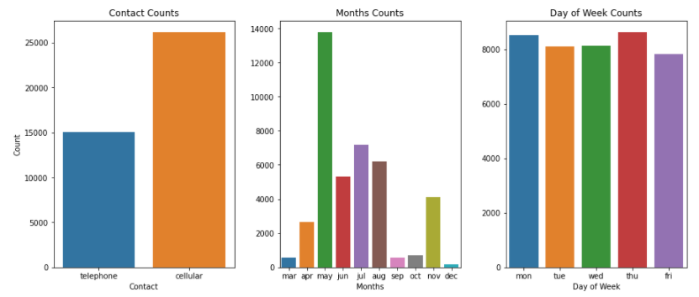
Methods - Count Plots
Straight forward visualization for categorical variables

Slide 9
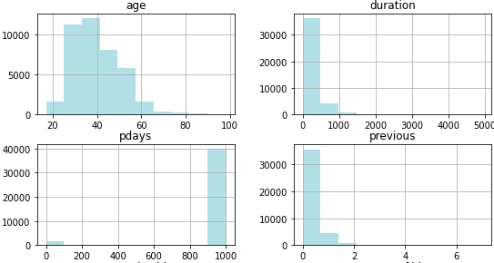
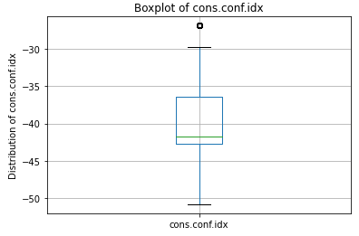
Methods - Box Plots & Histograms
More applicable for numerical variables
Helps identify outliers and other data hiccups

Slide 10
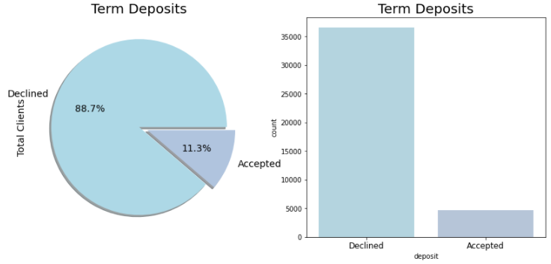
Methods - Multiple Chart Types
For the target variable, a pie chart is more appropriate as it gives the percentage of acceptance

Slide 11
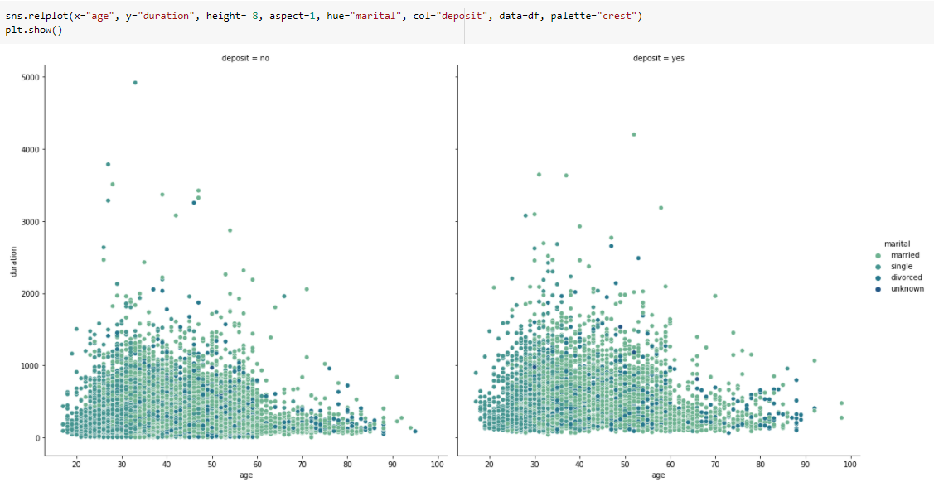
Methods - Relation Plots
Age vs. Duration can be separated into Yes and No’s for term deposits
Also has the Marriage variable color coded to include marital status

Slide 12
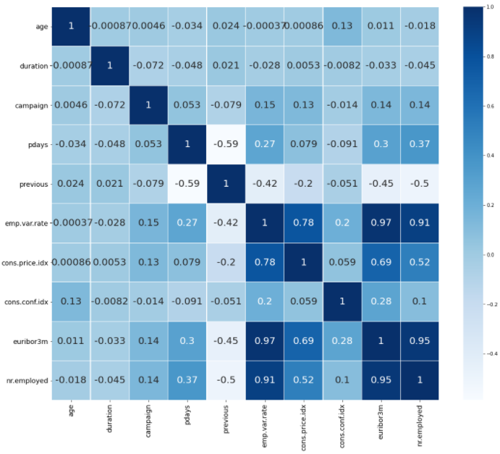
Methods - Heat Maps
Allows for quick identification of strong correlating variables
Each variable is given a number from -1:1 representing its correlation

Slide 13
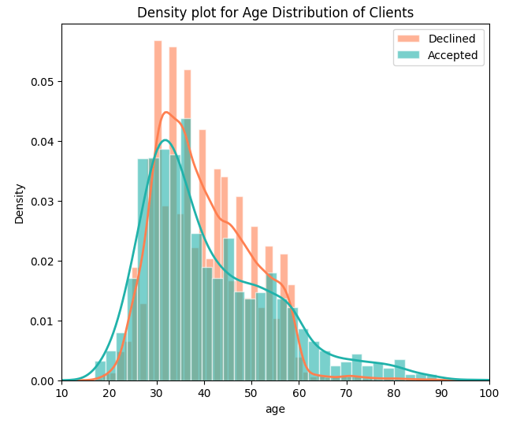
Methods - Density Plots
Records grouped by target variable and age
Then each of the subgroups within target variable are plotted

Slide 14







Data Pre-processing & Transformation
Removing Outliers
Cleaning Data Inconsistencies
Creating Indicator Variables
Standardization
Over-Sampling
Partitioning
Dimensionality Reduction
‹#›

Slide 15
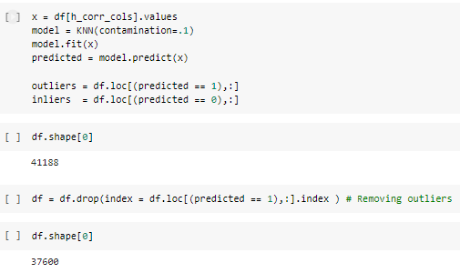
Preprocessing and Data Transformation - Removing Outliers
After using matplot to create boxplots for all variables and highlighting any with outliers, PyOD was used to remove the outliers
PyOD uses the K-Nearest-Neighbor (KNN) method
For any data point, the distance to its Kth nearest neighbor can be viewed as the outlying score

Slide 16
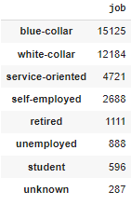
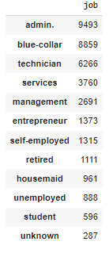
Preprocessing and Data Transformation - Data Inconsistencies
Some variables had subgroups which could be tied together in order to simplify and clean up the data
We used the .replace() feature to to clean up variables such as Education and Job
Entrepreneurship → self-employed
technician → blue collar
admin, mgmt → white collar
services, housemaid → service-oriented

Slide 17
Preprocessing and Data Transformation - Dummy/Indicator Variables
-Categorical variables were made into dummy/indicator columns by calling all variables with dtype object (df.select_dtypes(include[‘object’]).columns)
pandas feature pd.get_dummies() was utilized for this
These dummy columns can be used to represent subgroups in our regression analysis

Slide 18
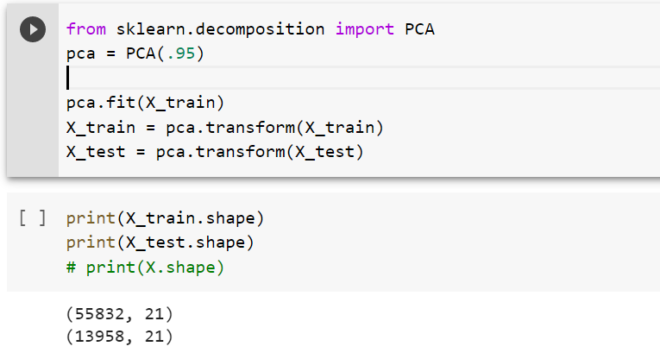
Data Reduction – Principal Component Analysis
Dimensionality Reduction using PCA
The code projects the original data which has 56 dimensions after creation of indicator variables into 21 principal components.
Together all 21 components contribute to 95% of the total variance.
Used for our first Modeling approach
‹#›

Slide 19
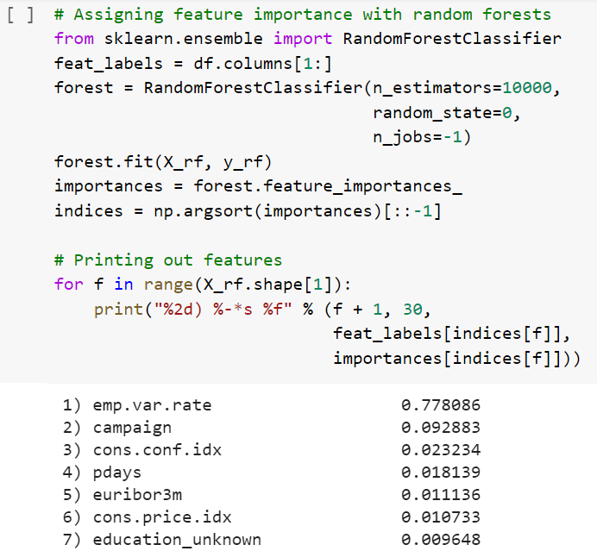
Data Reduction – Random Forest
Assessing feature importance with random forest classifiers
Utilized 36 variables with the highest variance
Used for our second Modeling approach
‹#›

Slide 20
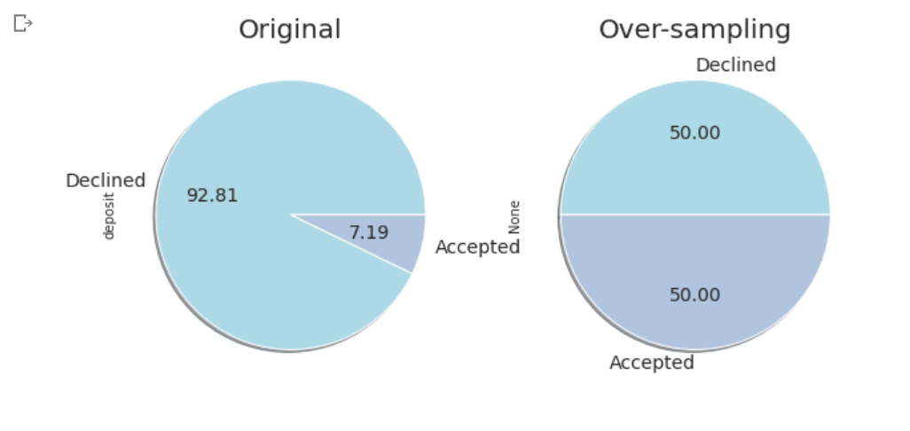
Over-Sampling
Used RandomOverSampler to fix the imbalanced dataset
Target variable
‹#›

Slide 21
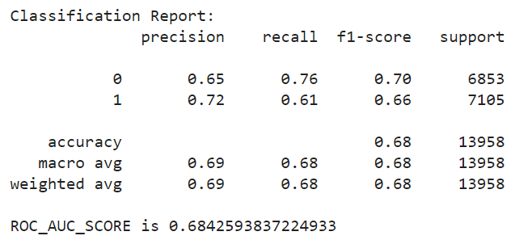
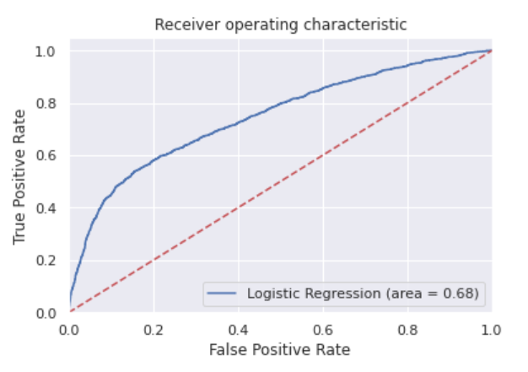
Modeling:Logistic Regression
Variables were selected by PCA
‹#›

Slide 22
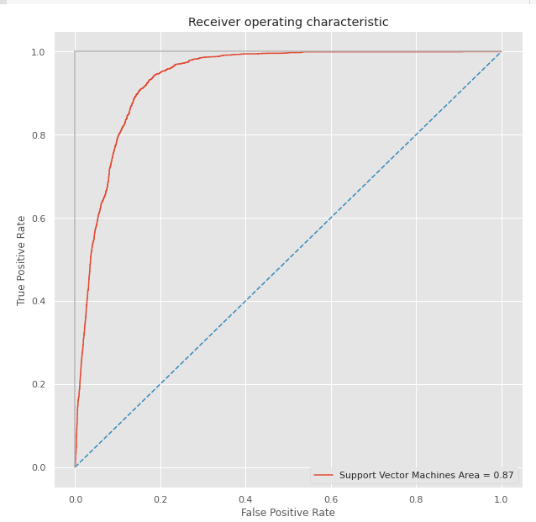
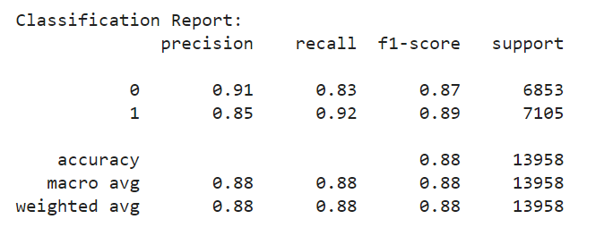
Modeling: Support Vector Machines

Slide 23
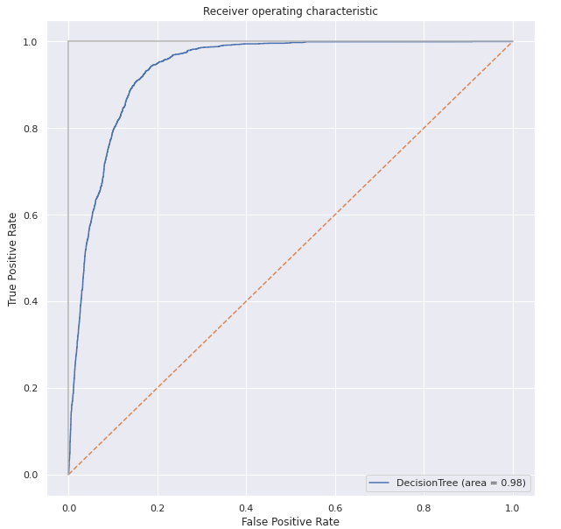
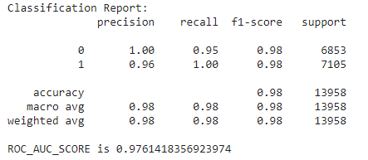
Modeling : Decision Tree

Slide 24
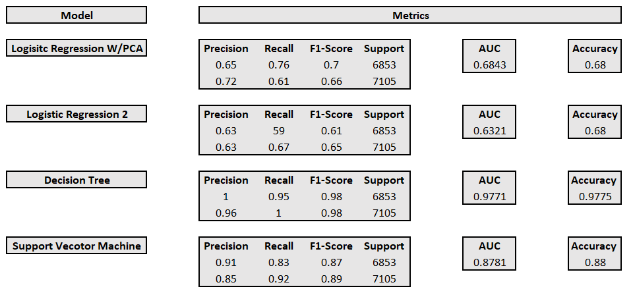
Model Comparison
‹#›

Slide 25
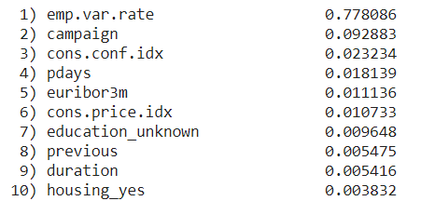
Business Recommendations
Four of the top ten factors were related to the economy
Three of the top ten factors where related to the customer contact
The bank should focus on the timing of their marketing campaigns in order to align them with the most favorable economic factors
Purchasing a term deposit was more likely when customer contact was low
Emphasizes importance of identify and closing sales early in the process
‹#›

Slide 26
References
Wisaeng, K. W. (2013). A Comparison of Different Classification Techniques for Bank Direct Marketing. A Comparison of Differn Classification Techniques for Bank Direct Marketing, 3(2231-2307).
Moro, S., Cortez, P., & Rita, P. (2014). A data-driven approach to predict the success of bank telemarketing. Decision Support Systems, 62, 22–31. https://doi.org/10.1016/j.dss.2014.03.001
Moro, S., Cortez, P., & Rita, P. (n.d.). Bank Marketing Data Set. UCI machine Learning Repository: Bank marketing data set. https://archive.ics.uci.edu/ml/datasets/bank+marketing.
Shapiro, B. B., & Wyman, J. (2014, August 1). New ways to reach your customers. Harvard Business Review. https://hbr.org/1981/07/new-ways-to-reach-your-customers.
‹#›

Slide 27
Thank You
‹#›

